Slide 1
Amazon Reviews Sentiment Analysis
Sai Venkata Manoj Vungarala
Ishal Abhishek Mummidivarapu
Vishnu Rohan Surapaneni
Abhishek Chandra Shukla

Slide 2
Problem Statement

Slide 3
In this project we are planning to develop a model to identify the positive and negative words used by the customers when they write reviews for the products.
We used a dataset consisting of 9 years amazon product review data(2005-2014).
Amazon follows 5 starred rating system, for the sake of convenience we are merging ratings:1-3 as bad and 4-5 as ‘good’.
So we will be preparing our own label set for that data.
We will build a sentiment analysis model as a part of NLP, based on the reviews of the products.

Slide 4
Introduction

Slide 5
Sentiment analysis is an application of natural language processing (NLP) that reveals the emotional states in human speech in this case, the speech and text that customers generate. Companies can use this tool to examine this text for positive or negative sentiment about the brand.
The aim is to improve the customer relationship and enhance customer loyalty.
The organization detects positive and negative sentiment in customer reviews, leading to an improved interaction with the customer.
This activity can result in more focused, empathetic responses to customers. As a result the online retailer maximize e-commerce sales, and the consumers, who want to have the best product over alternatives is satisfied.

Slide 6
Approach to solving the problem
Gather Amazon reviews data from stanford website.
Transform the JSON data into CSV format.
Analyze the data to determine the data quality
Preprocess the data: deal with the missing values and clean text feature and add required columns.
Exploratory data analysis
Apply feature extractions and NLP techniques and Selection Evaluation metric
Modeling and selecting the best model

Slide 7
Data and Preprocessing

Slide 8
This is 9 years beauty products amazon reviews between 2005-2014
The Data can be found in stanford website. Data source listed below
Data Source: http://snap.stanford.edu/data/amazon/productGraph/categoryFiles/reviews_Beauty_10.json.gz
The original data is in a JSON format there. In order to analyze the data, we need to transform the dataset into CSV format
This data includes 28798 rows and 9 feature variables.

Slide 9
Description of Data
Reviewer ID : ID of the reviewer, e.g. A2SUAM1J3GNN3B - type: object
ASIN : ID of the product , e.g. 0000013714 – type: object
Reviewer Name : Name of the reviewer – type: object
Helpful : Helpfulness of the review, e.g. 2/3 – type: object
Review Text : Text of the review – type: object
Overall : Rating – type: float64
Summary : Summary of the review – type: object
Unix Review Time :Time of the review (unix time) – type: int64
Review Time : Time of the review (raw) – type: object

Slide 10
Text Preprocessing
Remove tags
Remove accented characters
Expand contractions
Remove special characters
Lemmatization
Removing stopwords
Tokenization
Remove extra white space and digits
Spelling corrections
Grammatical Corrections
Remove repeated characters
Lower the text

Slide 11
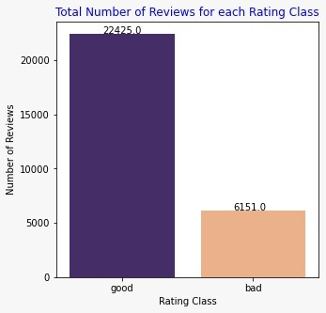
Data Distribution
We can clearly see this is class imbalance data, with 21.53% in the minority class and the rest in the majority class.
Data augmentation for the minority class is used to overcome the above problem and it is referred to as the Synthetic Minority Oversampling Technique, or SMOTE
Notes:
The challenge of working with imbalanced datasets is that most machine learning techniques will ignore, and in turn have poor performance on, the minority class, although typically it is performance on the minority class that is most important. Our approach to address imbalanced datasets is to oversample the minority class. The simplest approach involves duplicating examples in the minority class, although these examples don’t add any new information to the model. Instead, new examples can be synthesized from the existing examples. This is a type of data augmentation for the minority class and is referred to as the Synthetic Minority Oversampling Technique, or SMOTE. As it is a class imbalance problem F1 score is a better evaluation metrics than accuracy.

Slide 12
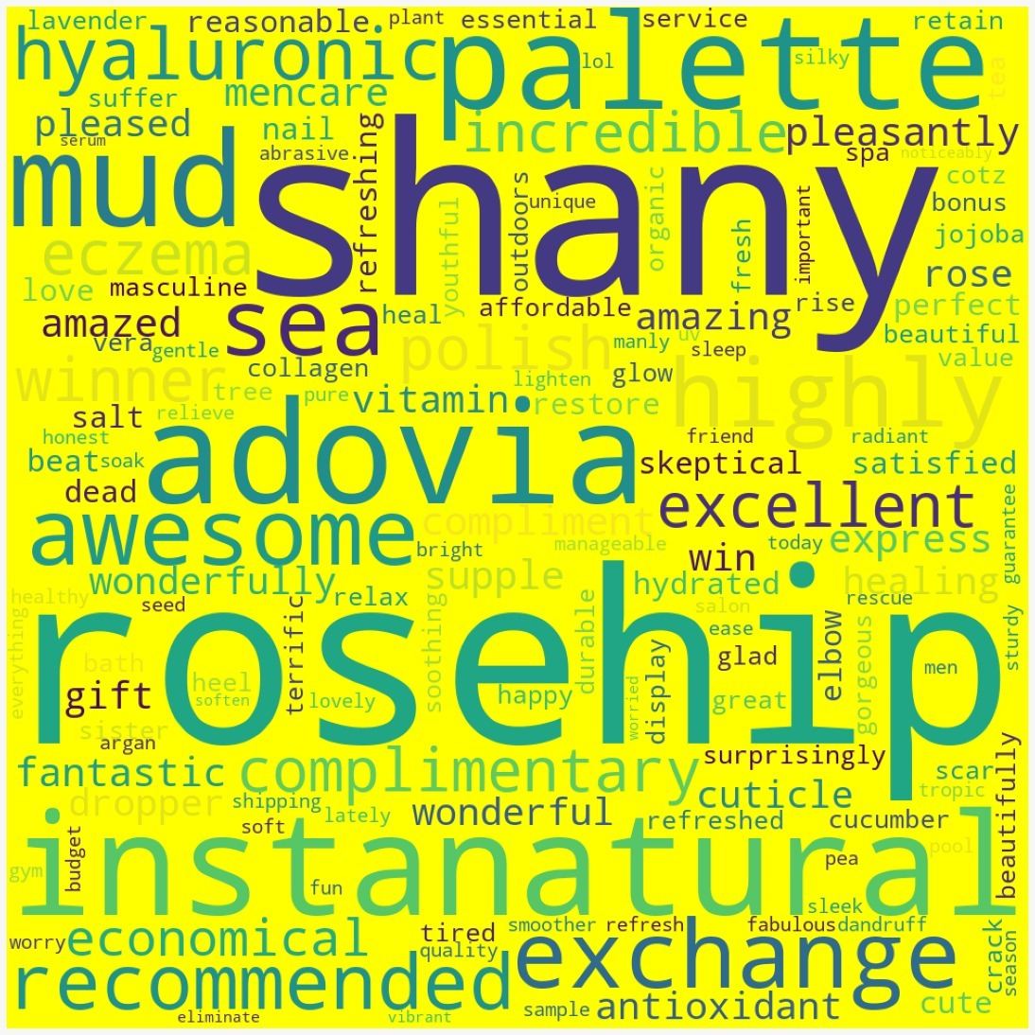
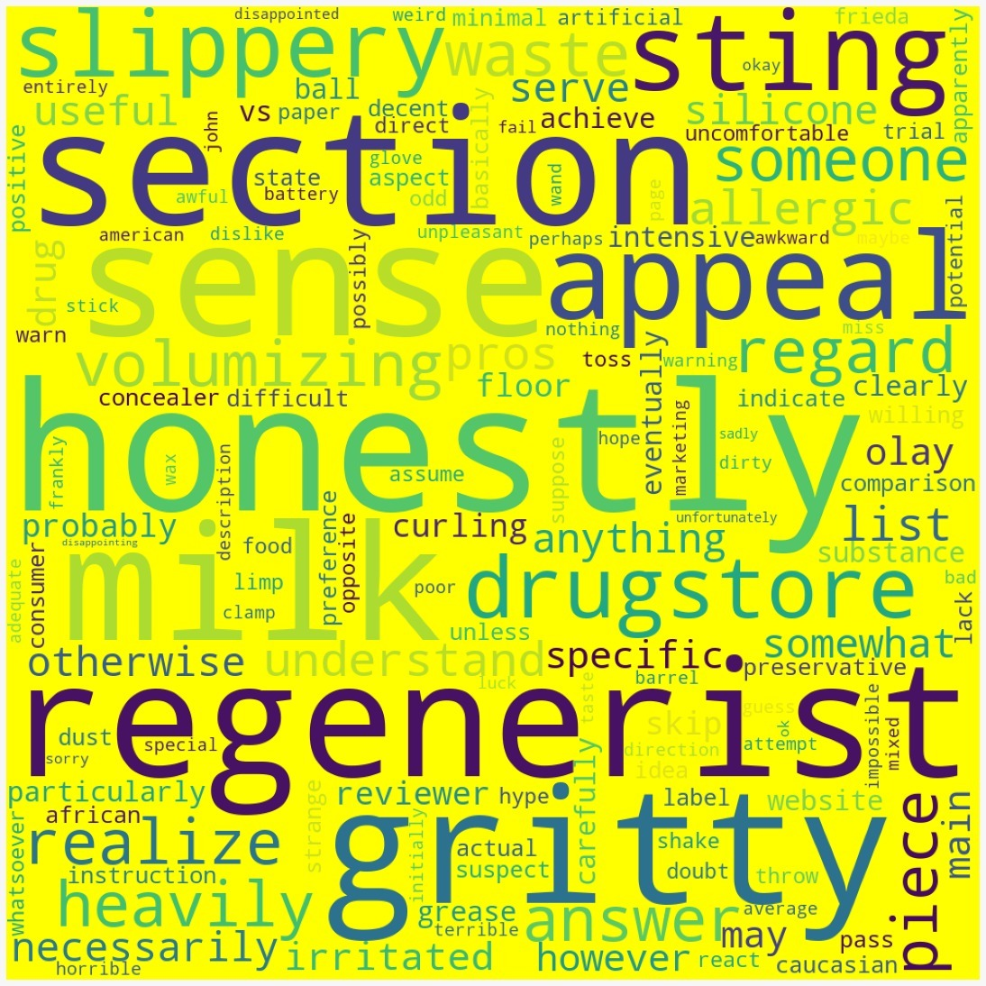
Features
Good Rating Words
The table shows the most common 50 words which belong to the good rating class. These words give us insight about what the products are and what kind of impression they have on the customers. For example, “Amazed” and “glad” words tell us that the products are appreciated in the reviews. Example 02: “Eczema”, and “Scar” tells us that the products are praised for covering them. Example 03: “Economical”, and “shipping” tells us that the products were reasonably priced and conveniently shipped to the customers. Example 04: “fresh” and ‘organic’‘ words tell us about the quality of products.
Bad Rating Words
The table shows the most common 50 words which belong to the bad rating class. These words give us insights about what the products are and what kind of impression they have on the customers. For example, “Wax” tells us that products made of wax have a complaint. Example02: “description” tells us that the product does not suit or work as per the description of the product.

Slide 13
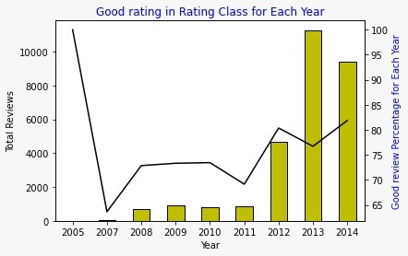
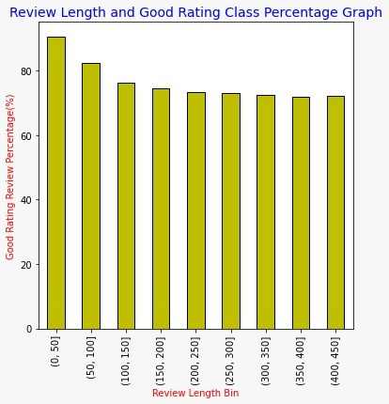
Year
For the years 2008, 2009, 2010, 2011 the percentage of good ratings was around the range 65%. After 2011, good ratings' percentage is progressing over 80%. Before 2012, only 2009 also showed a slight increase in good ratings and a decline from 2010 to 2011. Besides those, 2007 has the lowest good ratings with less than 65% overall. As it might be seen in the graph, the overall good rating is progressing between 60% and 85% in beauty products.
Review Length
From the graph, we can see that when the review length is between 0 to 50 bin, the good rating percentage is the highest at 90.4%. And when the length of the review is between 350- 400 bin the good rating percentage is 72.0% and 400-450 bin having 72.3. So we can conclude that when the length of the review increases, the good rating percentage decreases slightly. The difference between a good review with shortest length and a good review with longest length is 18.3%. So insightfully, customers have written longer reviews when they are displeased with their purchase.

Slide 14
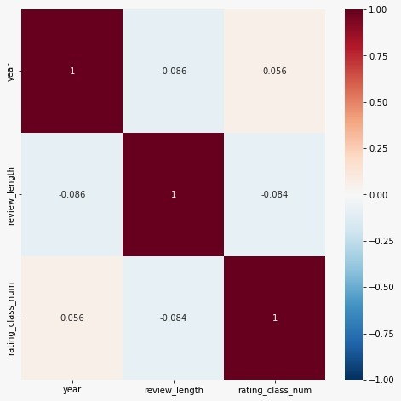
Correlation Between Numeric Variables
Correlation Between ‘year','review_length', 'rating_class_num
We can see that there is no strong correlation between any two numeric variables.

Slide 15
Methodology and Results

Slide 16
(i.) CountVectorizer: It breaks the sentences in words along with some basic pre-processing such as removing the punctuations, special characters etc. Words in a document are encoded in the form of indices and the count of occurrences of the word mapped to them. An encoding vector is returned whose length is equal to that of the entire vocabulary of the document. We have generated the word embedding using CountVectorizer word embeddings. We have used the SK-learns library to import the model class.
(ii.) TF-IDF: One of the most common practices to get a word embedding is one hot encoding. But this gives us a problem by giving more importance to the common words in the documents. And the less common words that are often the main differentiating factors between the documents are given less importance. On top of these word embeddings we have deployed 5 different NLP classification methods namely Naive Bayes classifier, XGBoost, Logistic Regression, CatBoost, and Random Forest.

Slide 17
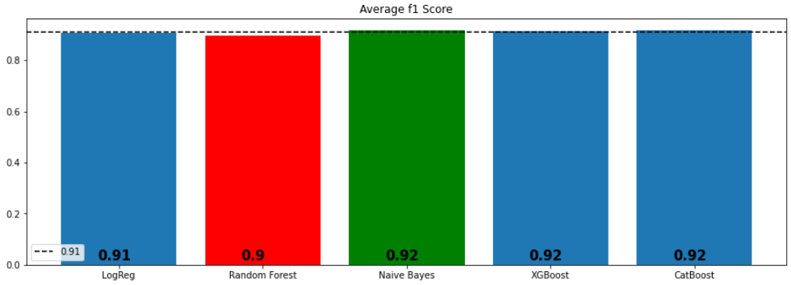
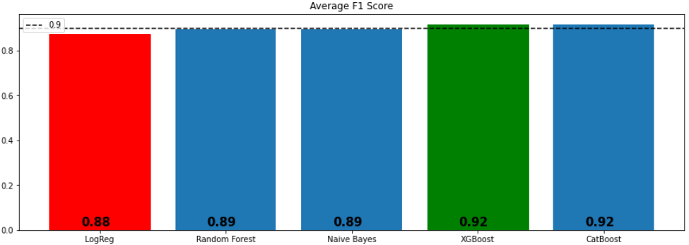
Model Accuracies
CountVectorizer
TF-IDF

Slide 18
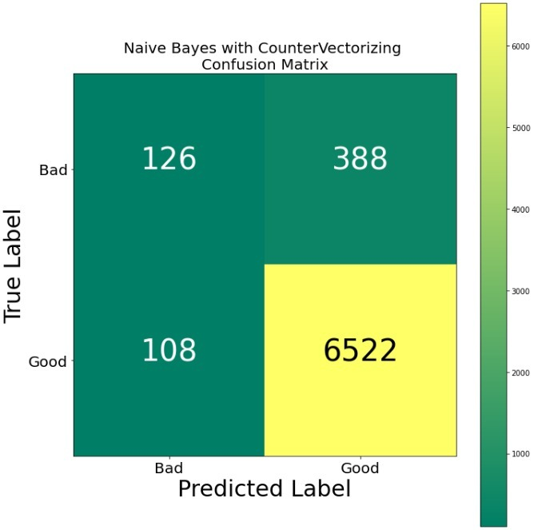
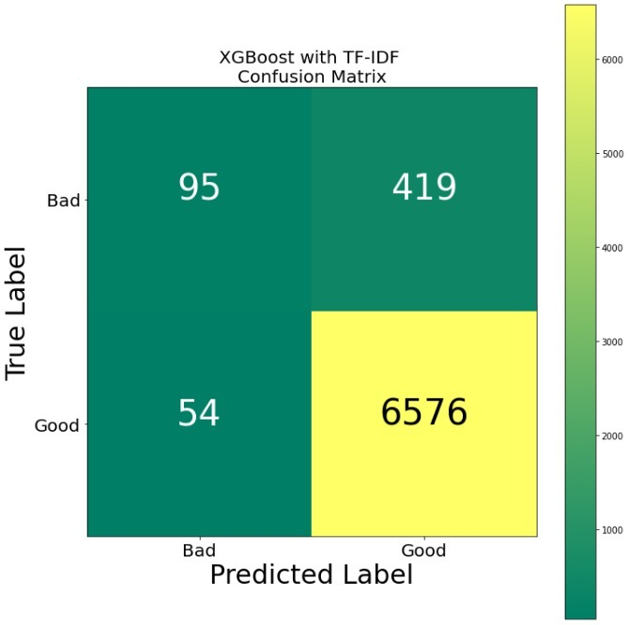
Confusion Matrices
CountVectorizer
TF-IDF

Slide 19
In order to see any changes in evaluation metrics, the most and least common 70 words were added to the stopwords list and models were applied. Once the cleaning is done, we then proceed with
(i.) CountVectorizer, where we convert a collection of text documents to a vector of term/token counts. Moving further, we apply the models and the best model for CountVectorizer turned out to be Naive Bayes and CatBoost.
(ii.) CountVectorizer (SMOTE), here we use SMOTE technique as the data is imbalanced. Once the data has been balanced using SMOTE, we apply the models to it. Naive Bayes has produced better results here as well.
(iii.) Truncated SVD, where data matrices with the number of columns equal to the truncation are factored using Truncated SVD. In this, Random Forest has produced better results.

Slide 20
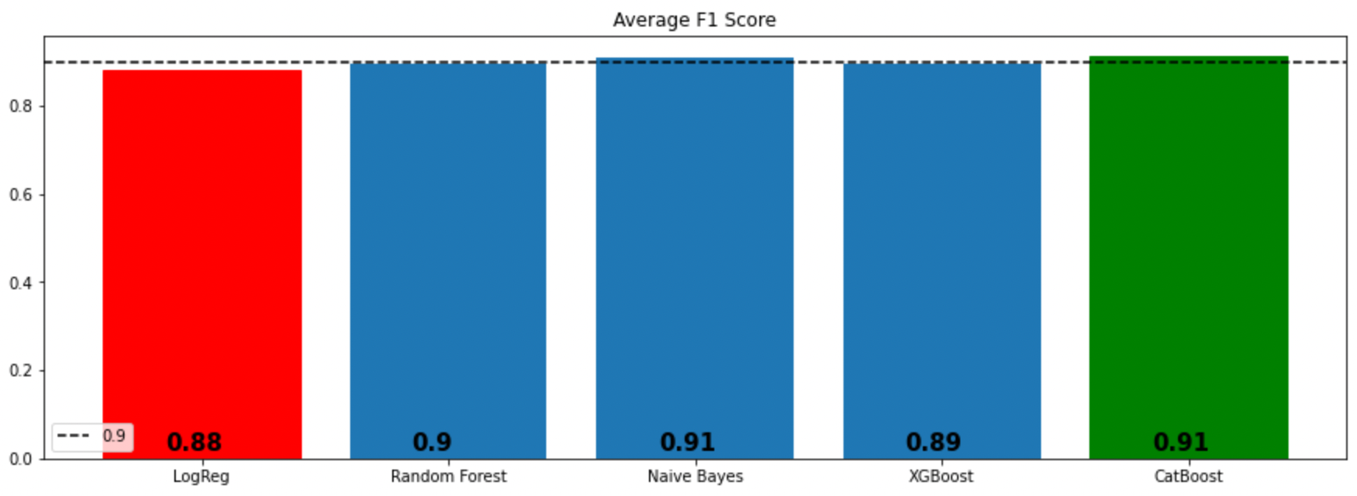
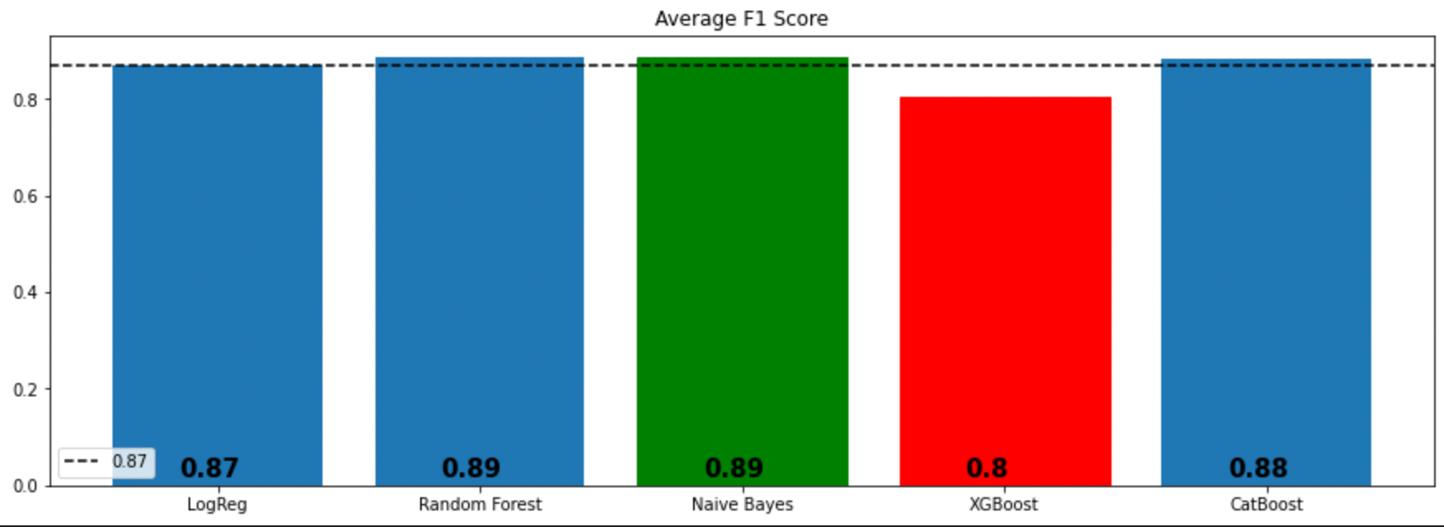
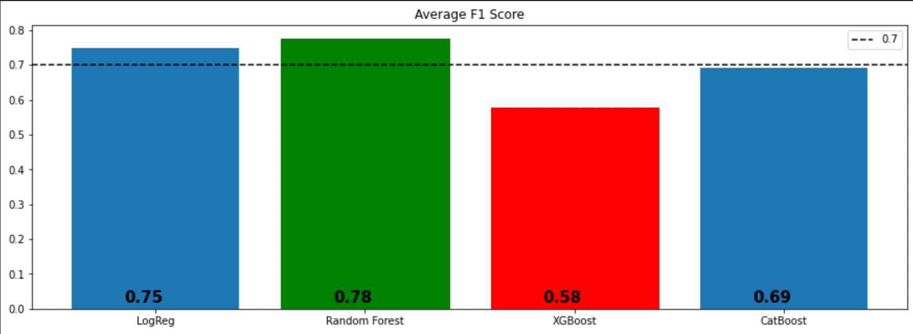
CountVectorizer
CountVectorizer
(After Applying SMOTE)
Truncated SVD

Slide 21
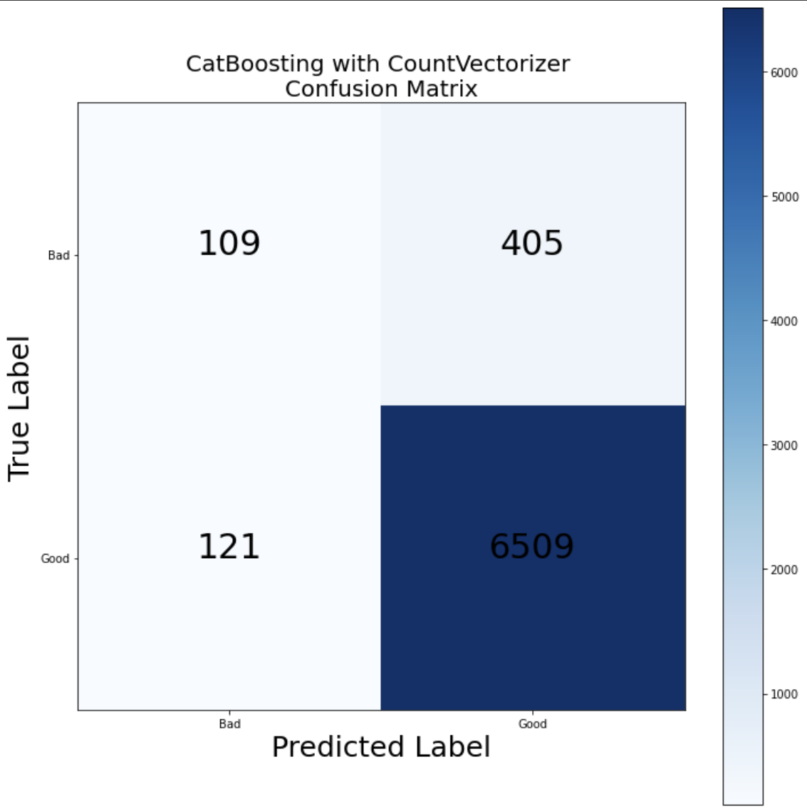

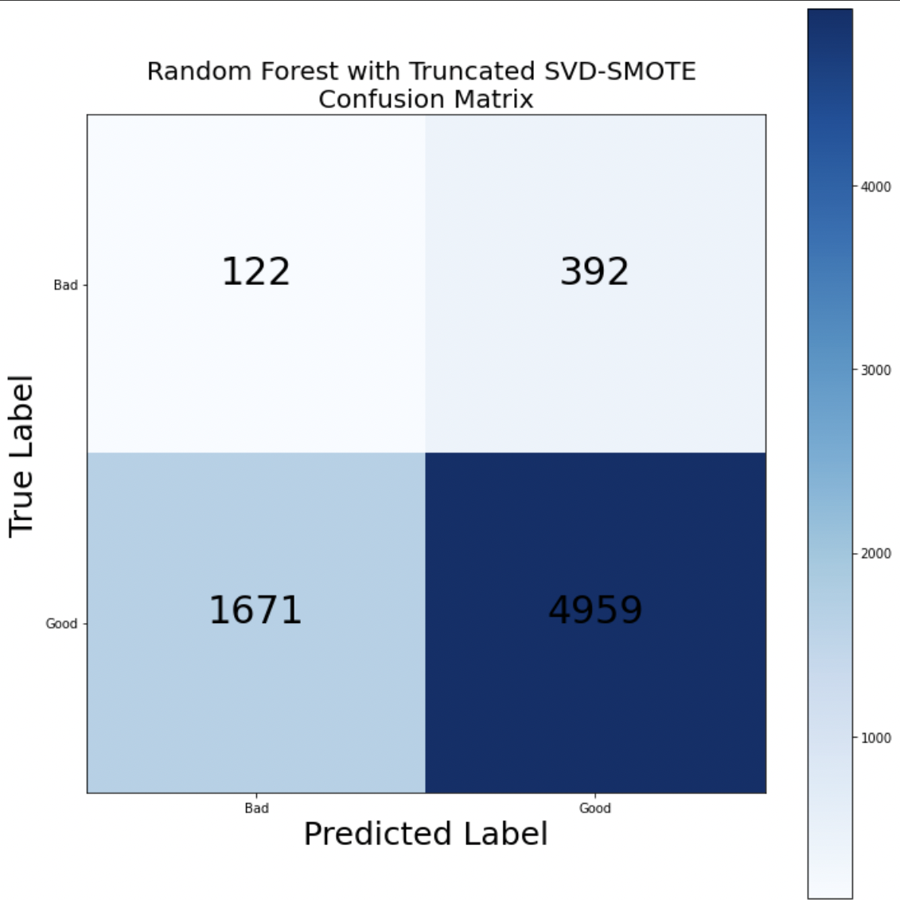
Confusion Matrices
CountVectorizer
CountVectorizer
(After Applying SMOTE)
Truncated SVD

Slide 22
Classification model using Word2Vec
For the more ambiguous cases where the statistical methods fail to capture the semantics of the word and its relation to the text, the classification becomes difficult. Therefore we are using the Word2Vec embeddings and getting results from the simple neural network.
The length of the generated word embedding vector is 100. We have used a Keras model for the implementation of the neural network. The sequential model we deployed had a embedding layer, flattening layer and 2 dense layers with sigmoid in the final layer for the binary classification.
Hyperparameters that gave the best results are:
Batch size: 32
optimize: rmsprop
Loss: Binary cross entropy

Slide 23
Classification using neural network
Running the model on the data for 12 epochs, the validation accuracy continuously took a dip.
Suggesting that the model is overfitting on the train data and performing poorly on the validation data.
Increasing the number of epochs, further widened the gap between the accuracy curves and validation curves.

Slide 24
Conclusion

Slide 25
We trained the classification models based on amazon customer reviews. Before diving deep into the results, it has been clear that preparation of data and feature engineering are critical to the model’s performance.
We word embedding techniques we used are:
Count Vectorization, TF-IDF vectorization, Word2Vec
Adding most and least common words to CountVect, SMOTE, Truncated SVD + SMOTE embedding techniques.
The classification models we used are:
Logistic Regression, Naive Bayes, XGBoost, CatBoost and Simple Neural Network
Naïve Bayes with Countvectorizer produced the best results with an f1 score of 0.924423.
Adding most and least common words to the stopword list didn’t have an impact on models’ performance.
Resampling technique also did not make a positive improvement of the model accuracy but decreased the model performance.

Slide 26
Future Scope
The more ambiguous cases such as “I was expecting better”, and “It was better than expected” should be solved by the neural networks.
Our model was overfitting on the data so the validation accuracy was low hence the classification of such ambiguous cases are not accurate.
In order to increase the accuracy we can decrease the number of learning parameters in our model which is close to 2.7 millions.
We can also use regularization, use simple cost and loss function along with shuffling the dataset before training to avoid the model from over-fitting.
Focus on hyperparameter tuning more using GridSearchCV library in python
Implementation of Deep Learning learning techniques and different layer combinations to get better results.

Slide 27
Responsibilities
We are four members and the workload of the project is evenly distributed among the team members.
Sai Venkata Manoj Vungarala : SMOTE-CountVectorizer and Truncated SVD implementation
Ishal Abhishek Mummidivarapu : Exploratory Data Analysis and CountVectorizer word embeddings
Vishnu Rohan Surapaneni : Data Pre-Processing and TF-Idf implementation
Abhishek Chandra Shukla : Word to vector word embeddings and Implementing neural network

